Slide 1
Parivartan Proposed DNS Plan

Slide 2








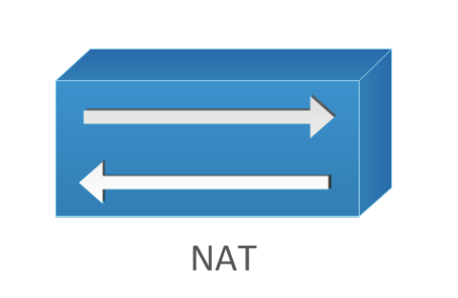
Apigee Edge WAF, oAuth, Token Validation
(WAF, Siteshield, DNS)
3rd Party APIs
Leased Line
DMZ
Core
TAS
DB Cluster
App Cluster
Ngnix cluster
NSX T0 Router
Oracle
DMS
Apigee Hybrid
Mongo
Kafka
Spring Cloud Gateway
Ngnix cluster
Redis Cache
Proxy Cluster
Spring Cloud
Microservices
jBPM
Elastic search
Drools
API Calls Via Internet
Web Portal URL Via Internet
API Calls Via Leased Line
Web Portal URL Via Leased Line

Slide 3
Proposed Domain Name:
parivartan.nseindia.com (Static Page)
*.dev2.Parivartan.nseindia.com (for DEV, SIT UAT Both)
*.prod.Parivartan.nseindia.com (for Prod)
*.sys. And *.app both the domains be part of public domain
Internet Users:-
Apigee → Akamai (DNS resolution) → TAS (Go Router)
Description:
1. Apigee will forward the request to Akamai for DNS Resolution
2. Akamai will forward the request to NSE on Prem and request is forwarded to TAS LB
Intranet Users :-
Hybrid Apigee -> Internal DNS Server → TAS (Go Router)
Description:
1. Hybrid Apigee will forward the request to Internal DNS Server
2. DNS will resolve and forward the request to TAS LB

Slide 4
Apigee to TAS Platform Flow
TAS Platform
NSX
LB
TAS Go Router
For Internet Users
1
Apigee Cloud
3
NAT
4
SCG
MS1
MS2
MS3
2
Akamai DNS Server
*.app.env.parivartan.nseindia.com
*.sys.env.parivartan.nseindia.com
TAS Platform
For Internal Users
NSX
LB
TAS Go Router
1
Apigee Hybrid
3
NAT
4
SCG
MS1
MS2
MS3
2
Internal DNS Server
*.app.env.parivartan.nseindia.com
*.sys.env.parivartan.nseindia.com

Slide 5
Intranet flow in Prod Environment*
Prod.Parivartan.nseindia.com
DC DNS Primary Server- 192.168.16.15
Primary Zone – 172.10.20.10
DR DNS Primary Server- 192.168.17.15
Primary Zone – 10.20.0.10
DC DNS Secondary Server- 192.168.16.16
Secondary Zone – 172.10.20.10
DR DNS Secondary Server- 192.168.17.16
Secondary Zone – 10.20.0.10
All ip address belongs to 172.10.20.0/24
All ip address belongs to
10.20.0.0/24
*IP Address are sample IP Address

Slide 6
Hosted Records Entries
Type of record | URL Pattern | IP | Target Servers/IPs
A | *.run.dev2.parivartan.nseindia.com |  | nsxt_lb_web_virtual_server_ip_address
A | *.cfapps.dev2.parivartan.nseindia.com |  | nsxt_lb_web_virtual_server_ip_address
A | *.app.dev2.parivartan.nseindia.com |  | nsxt_lb_web_virtual_server_ip_address
A | *.sys.dev2.parivartan.nseindia.com |  | nsxt_lb_web_virtual_server_ip_address
A | ssh.run.dev2.parivartan.nseindia.com |  | Cf ssh
A | opsmgr.dev2.parivartan.nseindia.com |  | Ops manager ip

